Slide 1
DEMO Connecting backend & frontend
Frenkel Alex
Github: alexfrenkel92
21.02.2020

Slide 2
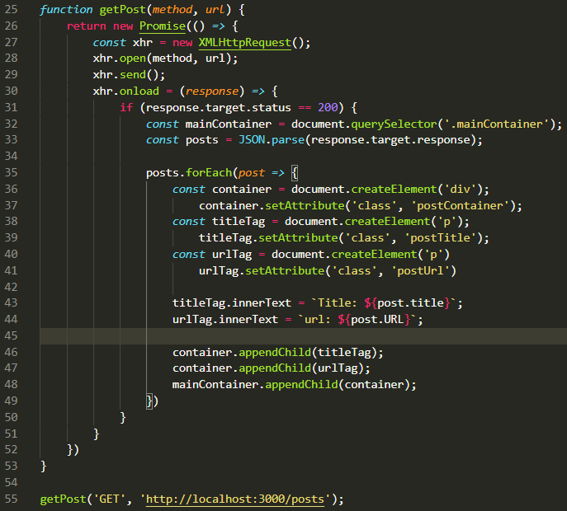
Get the post

Slide 3
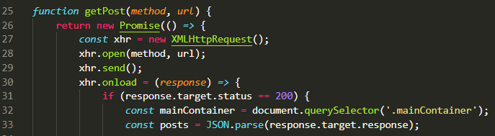
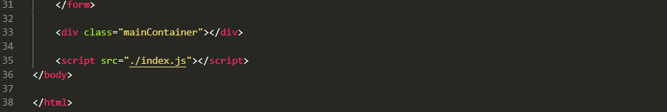
Part 1 – XMLHttpRequest

Slide 4
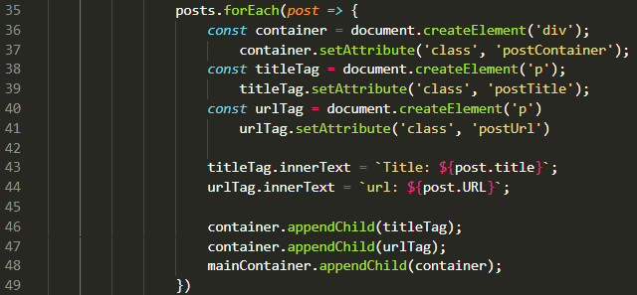
Part 2 – forEach, variables and appendChild

Slide 5
Get the post

Slide 6
